Slide 1
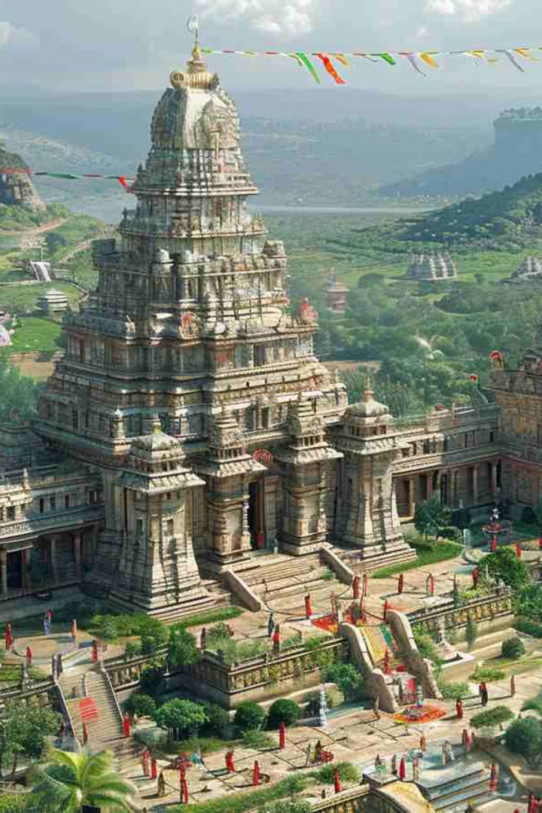






Tourism in Andhra Pradesh
Exploring the Land of Rich Heritage and Scenic Beauty: A Journey Through Andhra Pradesh. Andhra Pradesh, India, offers a rich blend of heritage, culture, and natural beauty.

Slide 2

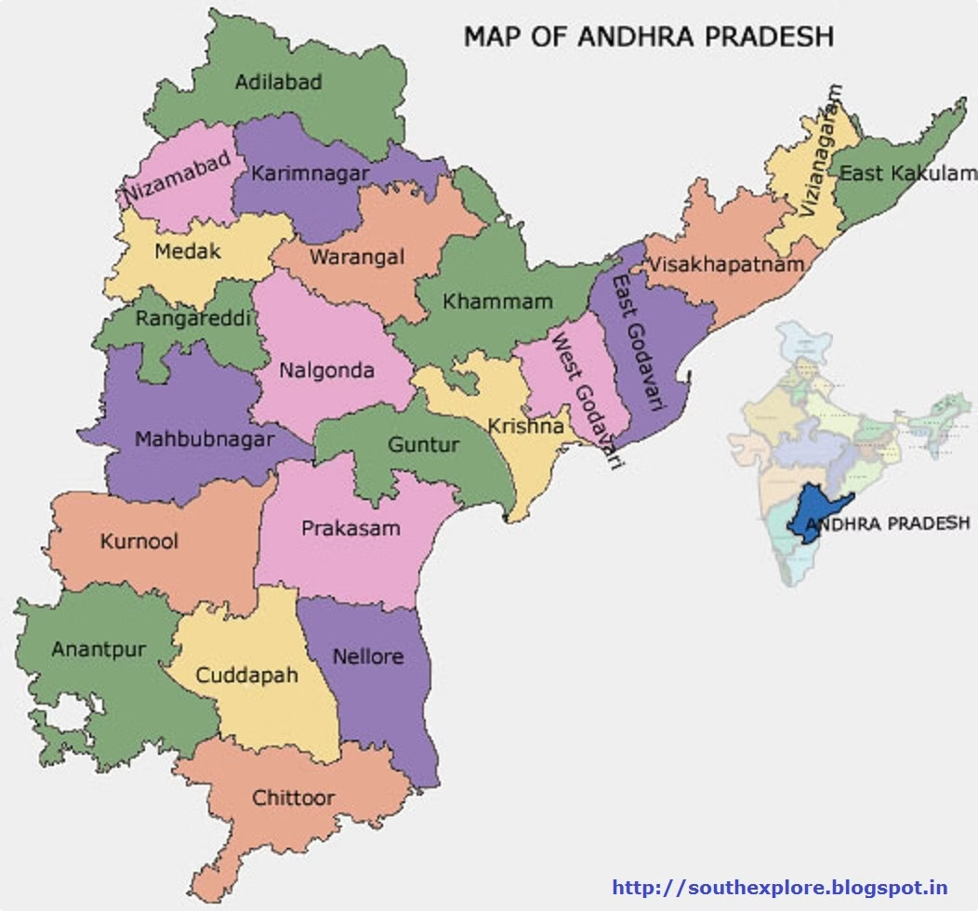







Andhra Pradesh: An Overview
Temples
Beaches
Hills
Ancient and ornate temples
Pristine coastlines
Lush landscapes
Historical Sites
Rich cultural heritage

Slide 3

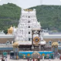
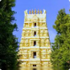
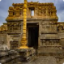
Spiritual Sanctuaries
Tirupati Balaji Temple
Srisailam Mallikarjuna Temple
World's richest and most visited temple
One of the twelve Jyotirlingas
Lepakshi Temple
Hanging pillar architecture marvel

Slide 4



Natural Beauty
Araku Valley
Horsley Hills
Lush green hills
Peaceful retreat
Coffee plantations
Panoramic views
Escape into nature's embrace.

Slide 5
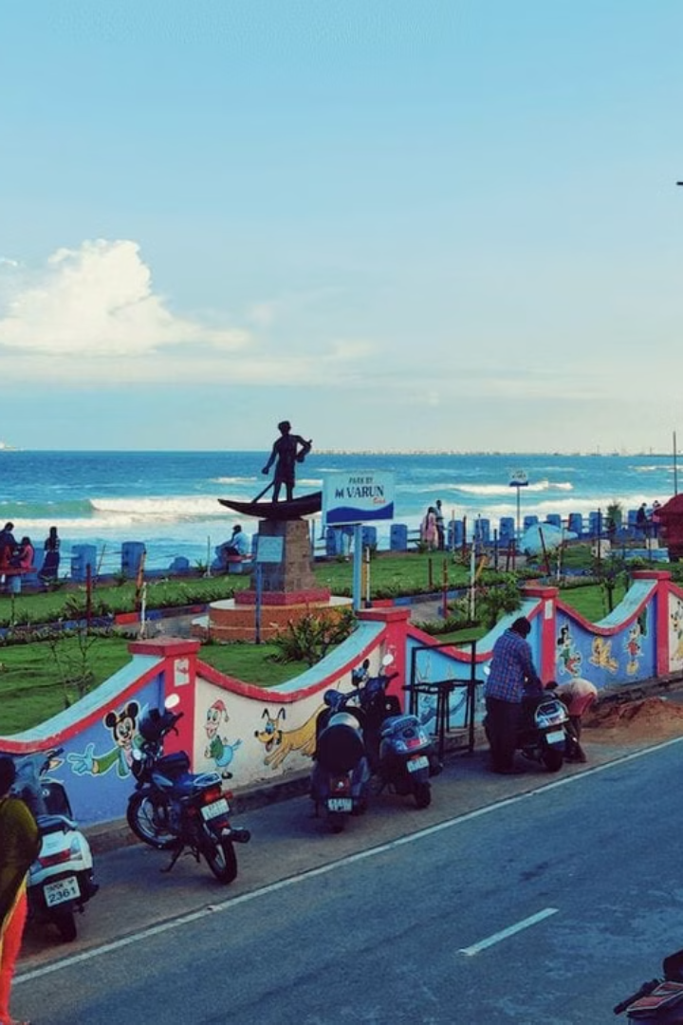




Beaches & Coastal
Vizag
Popular beaches
Rishikonda
Adventure sports
Kakinada
Wildlife sanctuary

Slide 6
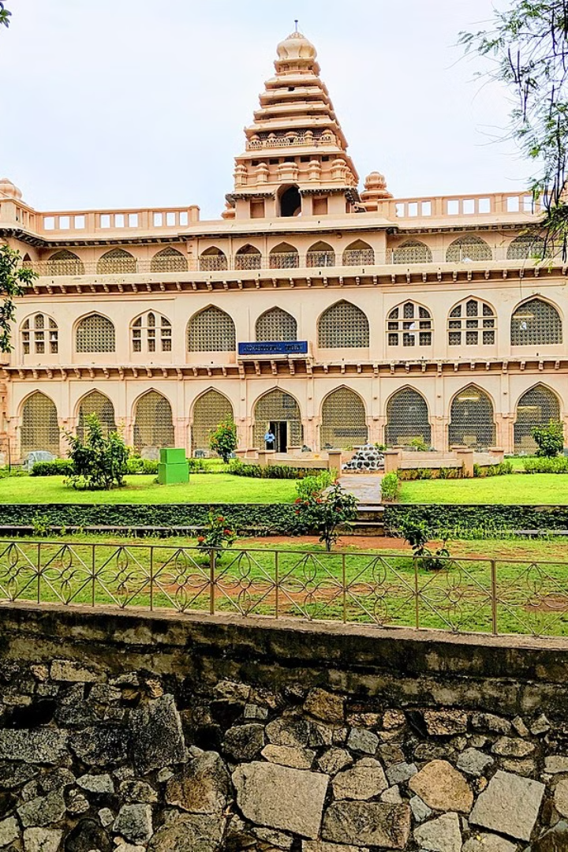



Historical Sites
Chandragiri Fort
Charminar of Andhra
Lepakshi
Vijayanagara architecture
Amaravati Stupa
Ancient Buddhist site

Slide 7

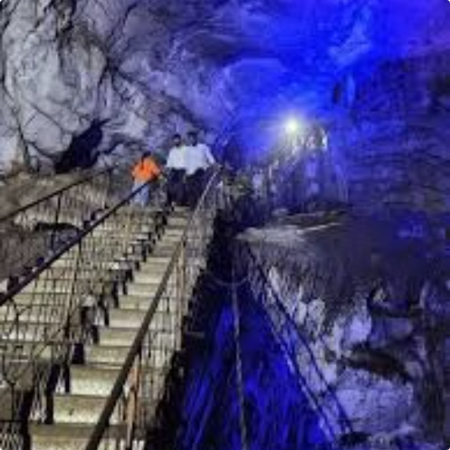
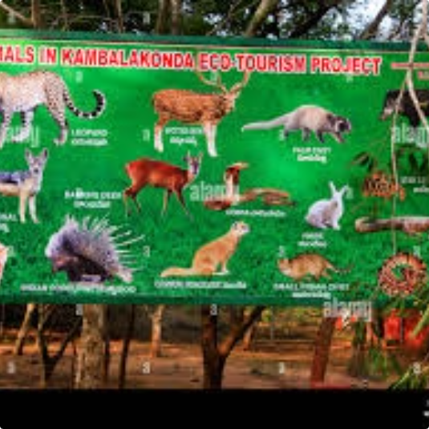



Adventure & Ecotourism
Gandikota
Borra Caves
Kambalakonda
Explore nature's wonders.

Slide 8
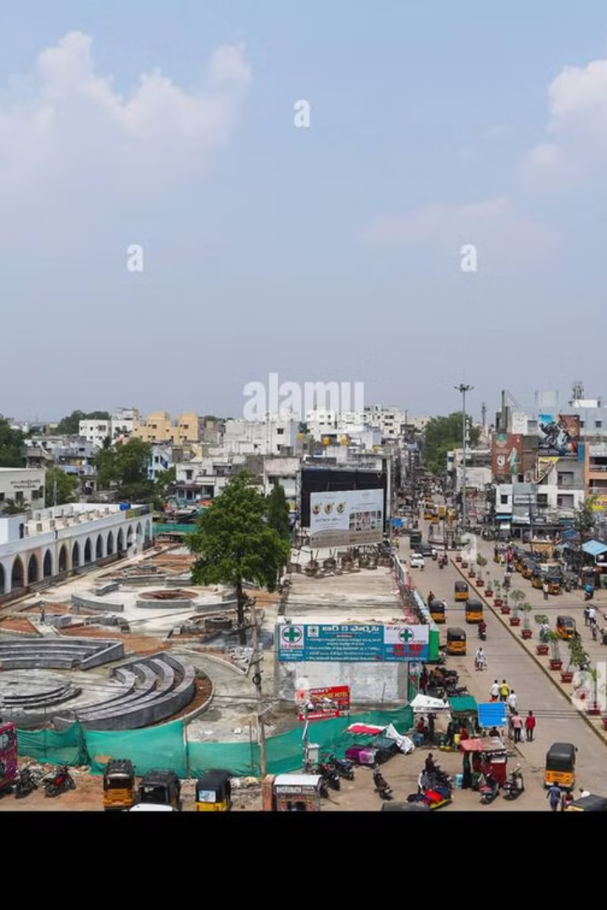
Tourism Growth
1
Government Initiatives
Development projects
2
Ecotourism
Sustainable practices
3
Heritage
Preservation efforts
Experience the soul of India in Andhra Pradesh!

